Slide 1
Testing CSSR
Correctness of CSSR

Slide 2
Related Slides
Marcel’s Testing outputs of CSSR and CSM
https://drive.google.com/open?id=1n7H-9OWUTggdn-vQUSndZIQLZuHHMQ1vloUHL6NJyFU
Julian’s CSM vs CSSR
https://drive.google.com/open?id=1fEMZCrc7bXESY6gmjBODa-dckXBvkjQmc2IEPuDTwTg

Slide 3
Aim
If given a known random markov chain, can CSSR generate a correct Epsilon machine.
A correct Epsilon machine should give a correct number of states.
Thus, statistical complexity should be more accurate.
Jump to conclusion

Slide 4
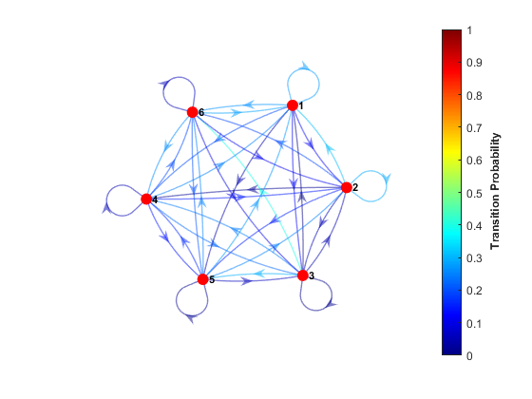
Real Random Process
Create a random Markov chain using mcmix in MATLAB.
Number of states = 6
Simulate this process by different steps
1,000 times
5,000 times
8,000 times
50,000 times (HCTSA limit)
100,000 times
10,000,000 times

Slide 5
Matlab Code
%% Create random Markov chain (or namely Epsilon machine)
rng(1); % For reproducibility
num_states = 6;
mc = mcmix(num_states);
figure(1), graphplot(mc,'ColorEdges',true);
%% Simulation of Statistical Complexity
disp('Start to simulate.......')
numSteps = 8000; % how many times to execute the same random process.
X = simulate(mc,numSteps);
disp('Simulation finished. ')
indata = char(X' + 64);
disp('CSSR')
% CSSR algorithm here

Slide 6
CSSR parameters
Significance level is fixed as 0.001
History length is chosen from 1 to L
L = log(N)/log(A)

Slide 7
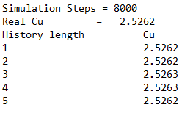
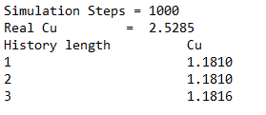
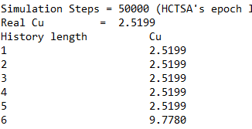
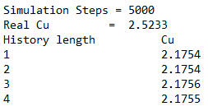
Results
(1)
(3)
(2)
(4)

Slide 8
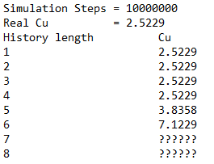
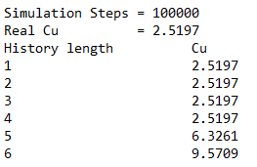
Results
(5)
(6)

Slide 9
Suggestion
http://bactra.org/CSSR/ReadMe.html#tth_sEc4
http://bactra.org/CSSR/ReadMe.html#tth_sEc5
Recommended
L should approximate the true markov order, If L is too large, “blow-up” in number of causal state.
We suggest exploring the data at low L and high s initially, and then increasing L and lowering s. If a stable architecture is found, it should be recorded at the lowest possible L.

Slide 10
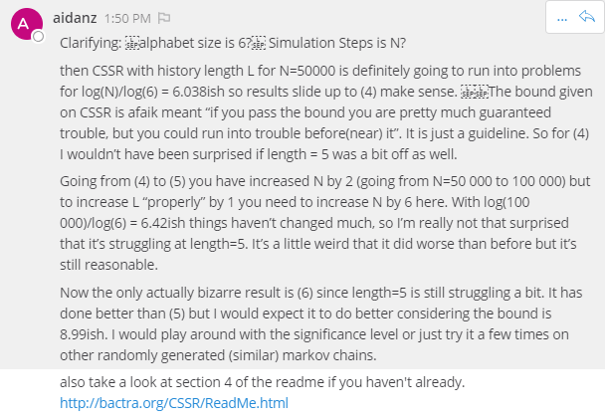
Suggestion

Slide 11
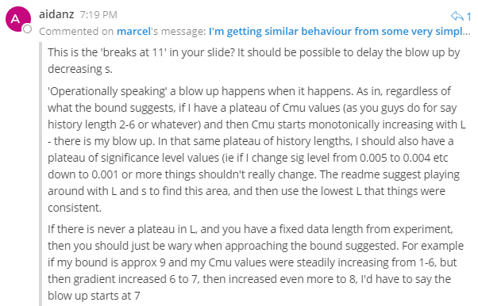
Suggestion

Slide 12
Conclusion
…….

